Slide 1
Reproducible Clinical Data Analysis with R* Preview
*Please send me suggestions for a better title

Slide 2
A motivating example: The Duke Cancer Trials Scandal
A recent high-profile case where several things went wrong in the data analysis
Why high-profile?
Patient therapy was involved
It took a long time and large effort to figure out what had happened
Errors vs misconduct
In the end, 10 papers were retracted (incl. NEJM, Nat Med, JAMA, Lancet Onc, JCO), and Duke settled lawsuits with 11+ patients
Common themes
Complex high-dimensional data
Incomplete descriptions of methods
Common mistakes are simple; simple mistakes are common
Lack of code hides simplicity
Adapted from Keith Baggerly

Slide 3
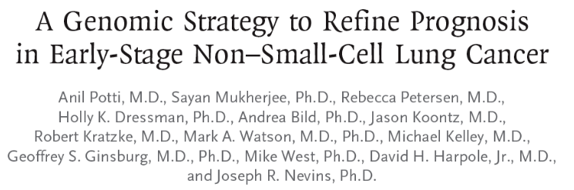
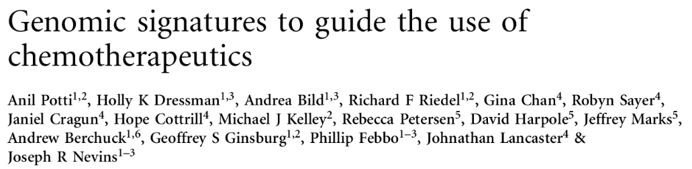
Predicting sensitivity to chemotherapy from microarray “gene signatures”
Potti et al. 2006 NEJM 355:570-80
Potti et al. 2006 Nature Med 12:1294-1300
The NCI tests each chemotherapeutic on a panel of 60 cell lines (NCI60). The sensitivity data is publicly available
Microarray analysis of each NCI60 cell line to create a predictive model of gene expression profiles → drug sensitivity
Examples provided for 7 commonly used chemotherapeutic agents
Adapted from Keith Baggerly

Slide 4
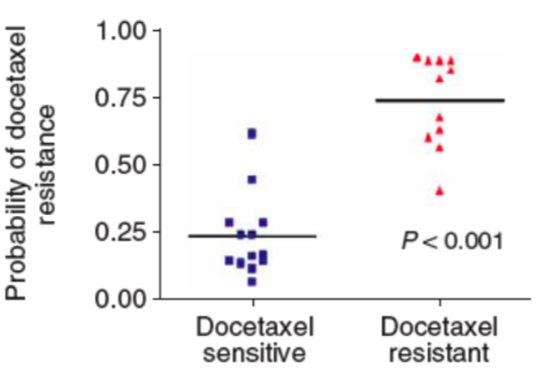

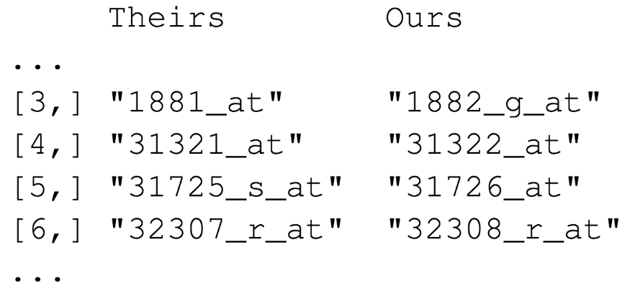
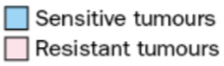
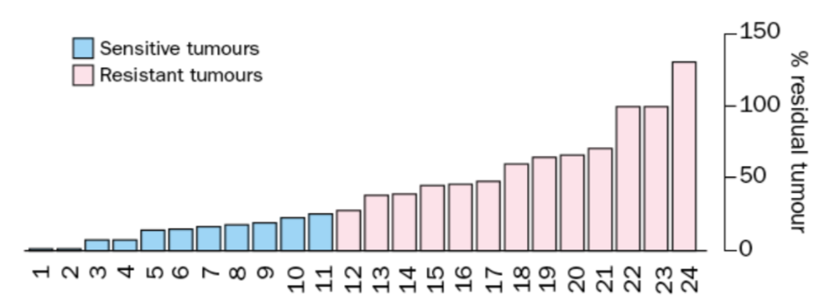
While all the data was publicly available, the code was not
Baggerly et al. attempted to reproduce the data without success
After a major “forensic bioinformatics” effort they uncovered numerous data errors
Potti et al. 2006 Nature Med 12:1294-1300
n = 13
n = 11
n = 11
n = 13
Chang et al. 2003 Lancet 362:362-9
Adapted from Keith Baggerly
Notes:
Off-by-one indexing error of microarray probe set included in the models for 6/7 of the chemo drugs. This is what happens when you copy and paste a table from excel with a header line into a program that does not expect a header line
Adriamycin sensitive/resistant label switched… original source: most samples were labeled as adria-sensitive; here: most labeled as resistant
Patient allocation in trials guided by sens/resistant labeling !

Slide 5
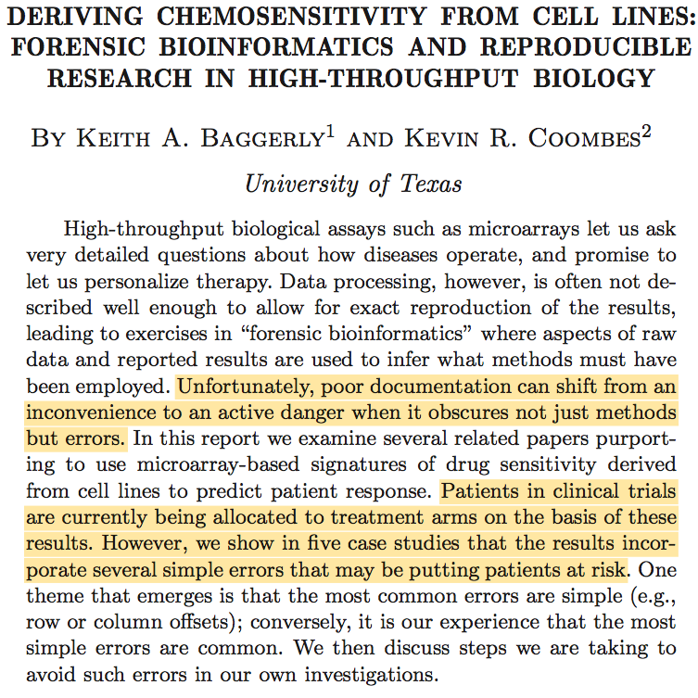
2009 Ann Appl Stat 3:1309-34

Slide 6
A few less extreme examples…
“Remember that analysis you did six months ago? We would like to look where things are now. Can you repeat the analysis?”
“The resident who looked at the data before is no longer here. Can you look at what she did and analyze the new data set using the same methods?”
“Please write/edit the Methods sections for the abstract/paper/grant proposal I am submitting based on the analysis you did several months ago.”
Adapted from Keith Baggerly

Slide 7
“The results in Table 1 don’t seem to correspond to those in Figure 2.”
“Where did I get this data file?”
”How did I create this figure?”
“Why did I decide to omit those six samples?”
Your closest collaborator is YOU from six months ago.
But you don’t reply to e-mails.
Credit: Karl Broman

Slide 8
Point-and-click vs scripting
Learning curve: Point-and-click software might be easier to learn than a scripting language
Documentation: Your code precisely documents your analysis.
Automation: Code makes it trivial to rerun your analysis with new or updated data.
Collaboration (including with yourself from six months ago!):
Reviewing your analysis with your peer or mentor or sharing it with a collaborator is easier with code.
Adapted from Mine Çetinkaya-Rundel

Slide 9
Why R?
Programming language for data analysis
Free and open source
Widely used and very well documented
Large online user community means answers to most common problems are only a Google search away
Compatible with Windows, macOS, Linux
Thousands of statistical data analysis packages
Built-in support for literate programming via knitr + R Markdown
Adapted from Mine Çetinkaya-Rundel

Slide 10
(Why not programming language X?)
There are a number of other great programming tools out there that can also be used to improve the reproducibility of your analysis
The key is to use some type of language that will allow you to automate and document your analysis
Once you master one language you'll probably find it easier to learn another
Credit: Mine Çetinkaya-Rundel

Slide 11
Literate Programming
Interweave descriptive text, code, and results in a single document.
Chunks of code load data and compute results
Presentation code formats results (tables, figures, etc.)
Article text explains what’s going on
Pros:
Everything is in one place!
Allows you to focus on the data analysis instead of the details of the outcome
Provides a logical place for documenting details of data sources and rationale for specific design decisions
Simplifies review for methodological issues and data errors
Cons:
Everything is in one place!
Document processing can be slow for complex analyses (can be cached though!)
Adapted from Roger Peng

Slide 12
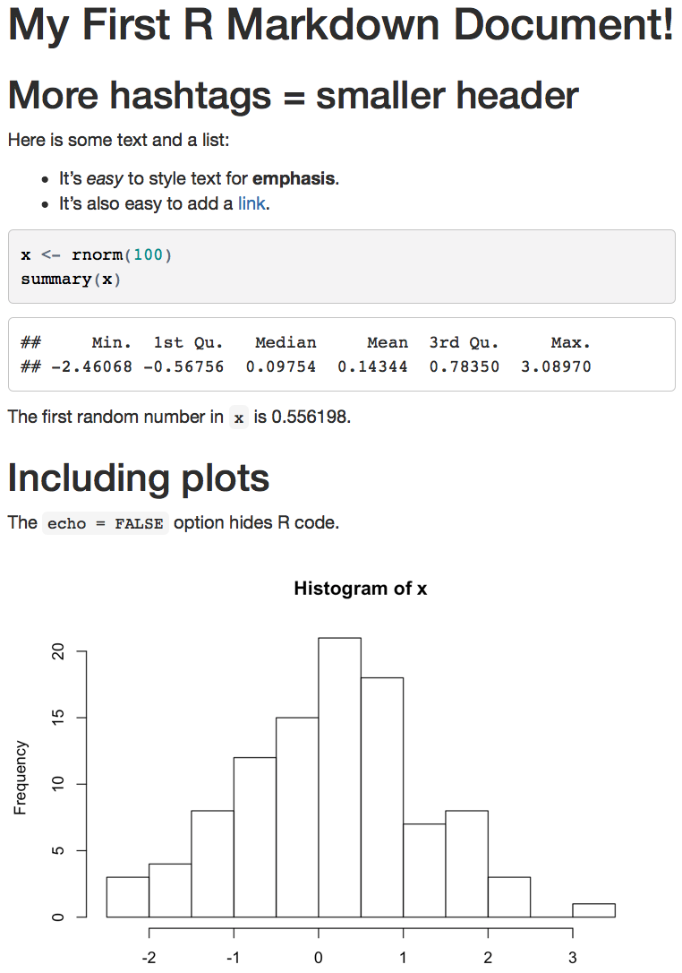
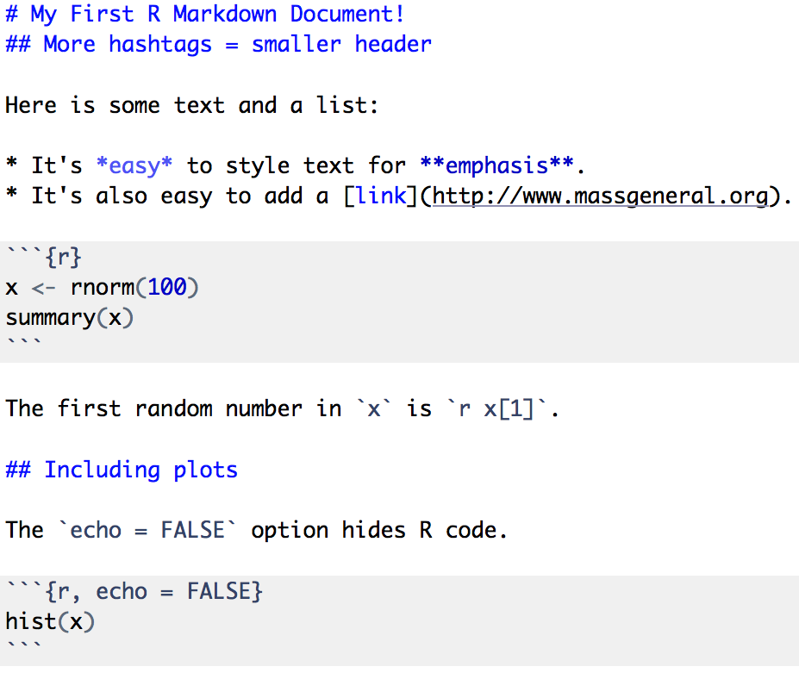
Notes:
Stuff to point out:
- Code chunks vs inline code
The second code chunk remembers the variable x from the first code chunk! You can really hack up your program into tiny bits and include copious explanatory comments in between the chunks!
This is pretty much all of the Markdown you need to know. The rest is R.

Slide 13
The Data Analysis Workflow
Source: R for Data Science (Wickham, Grolemund)
Notes:
The goal of this course is to enable you to write an entire data analysis, from import until the final graphs and tables, in a single R Markdown document (or for very large analyses, a small number of documents).

Slide 14
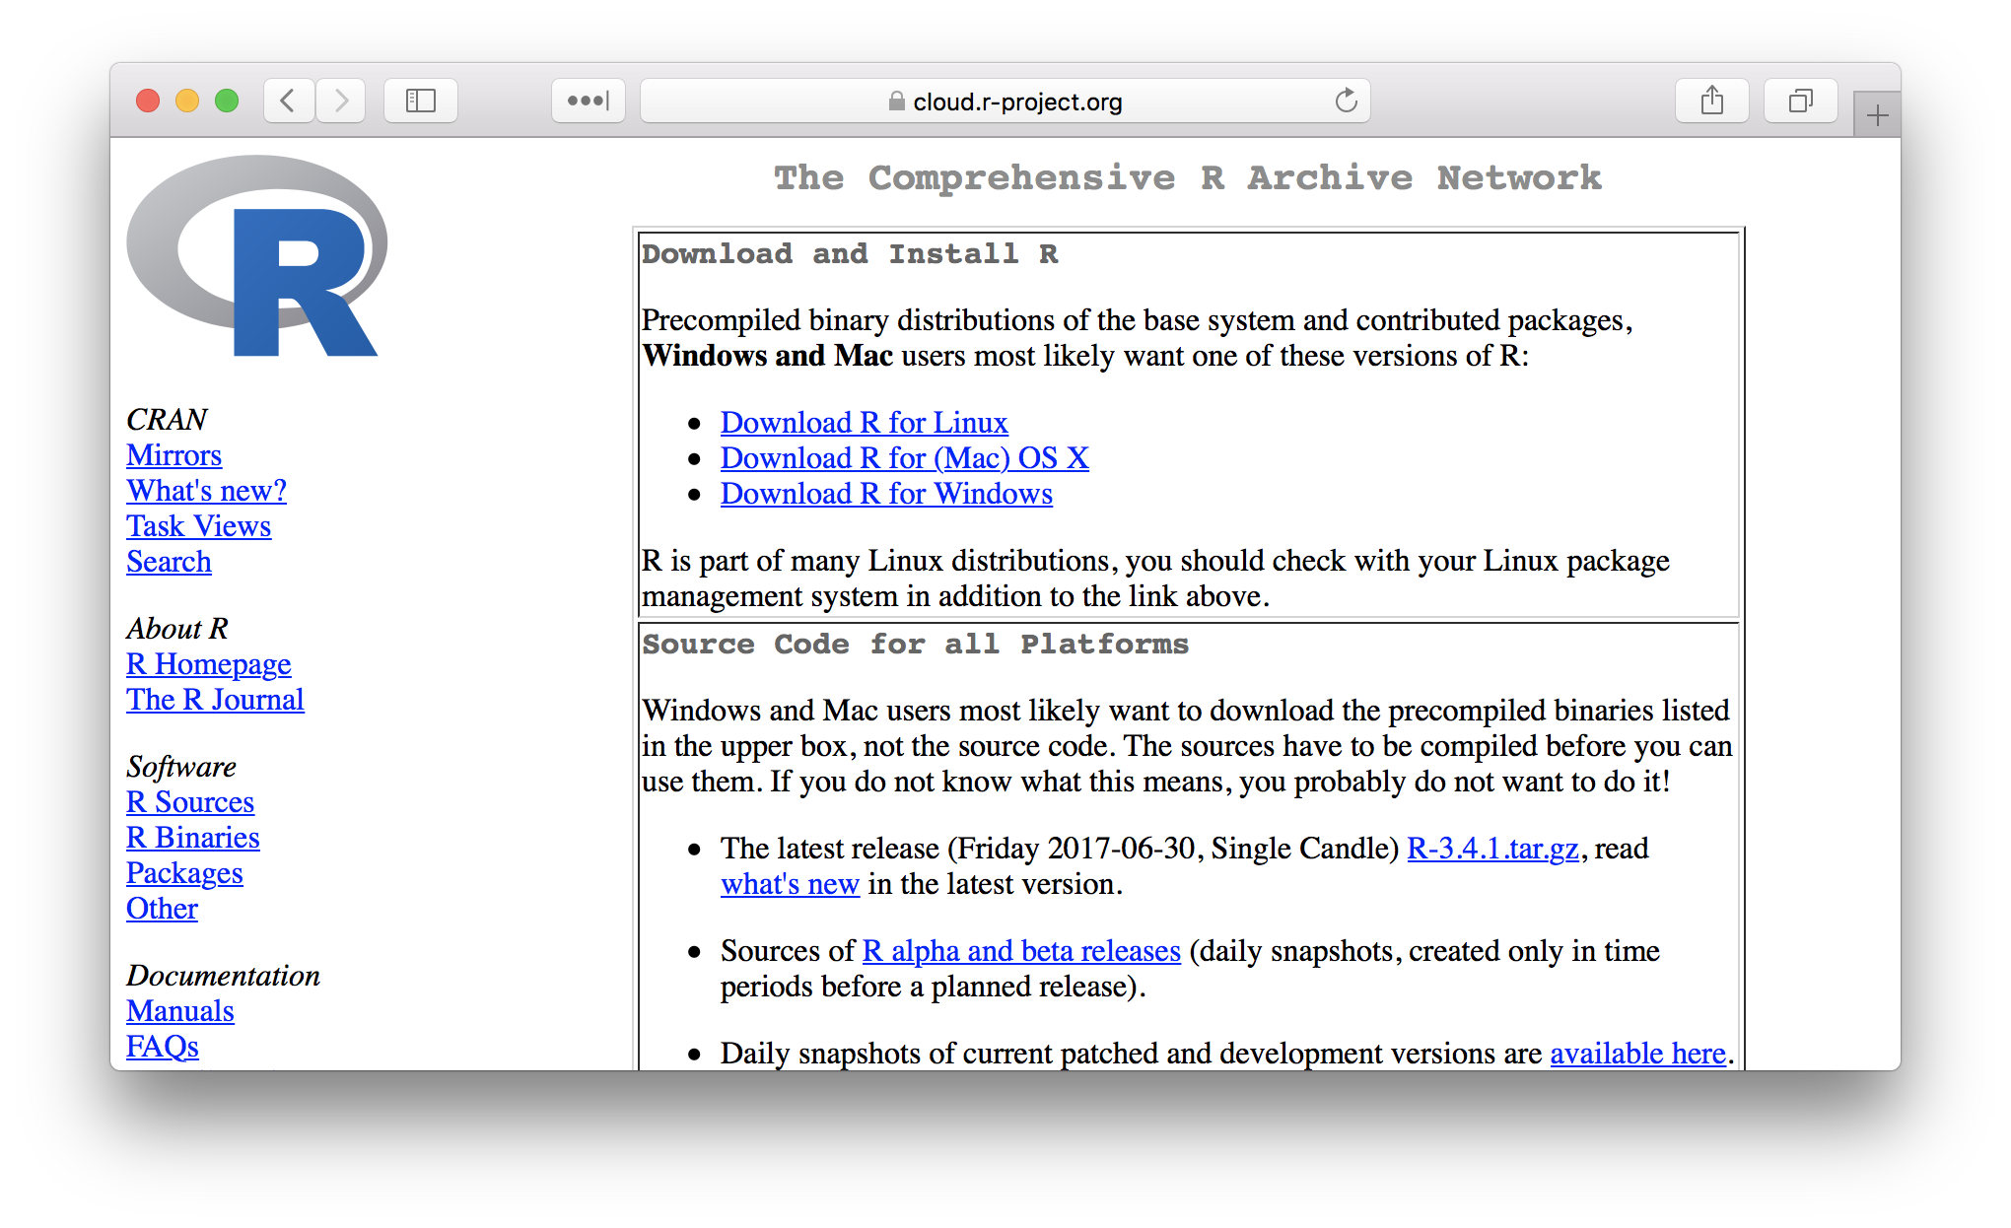

Slide 15
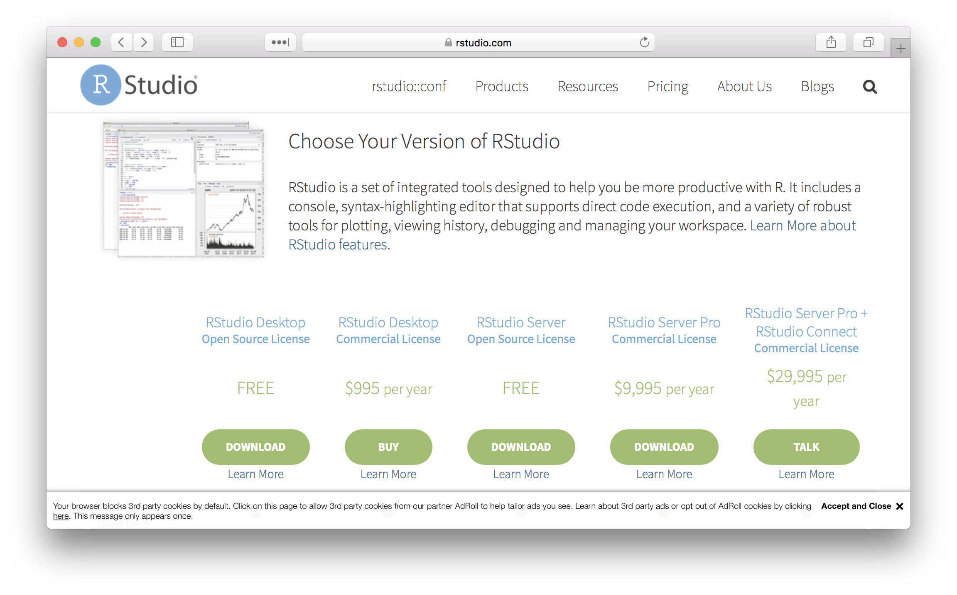

Slide 16
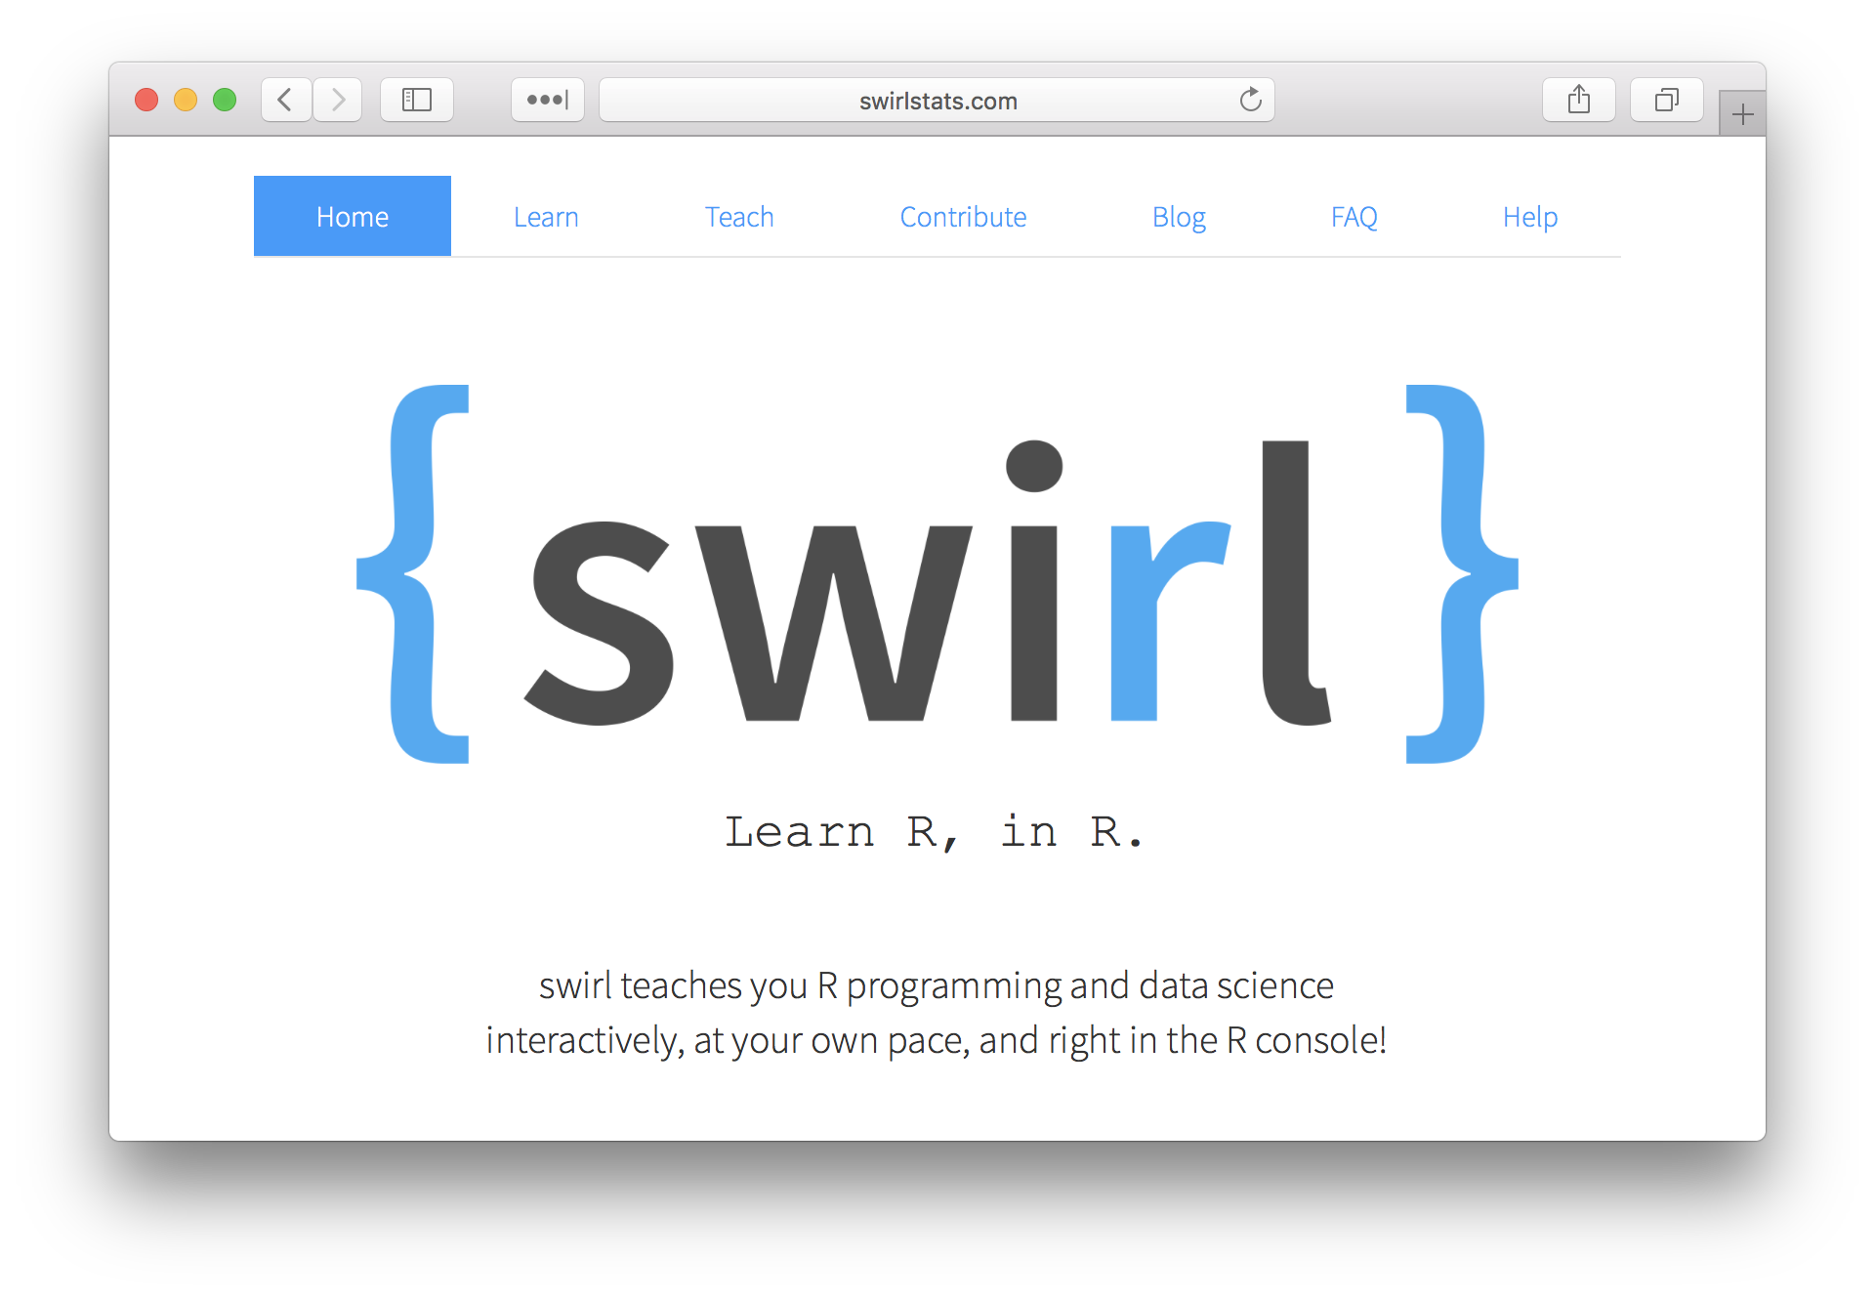

Slide 17
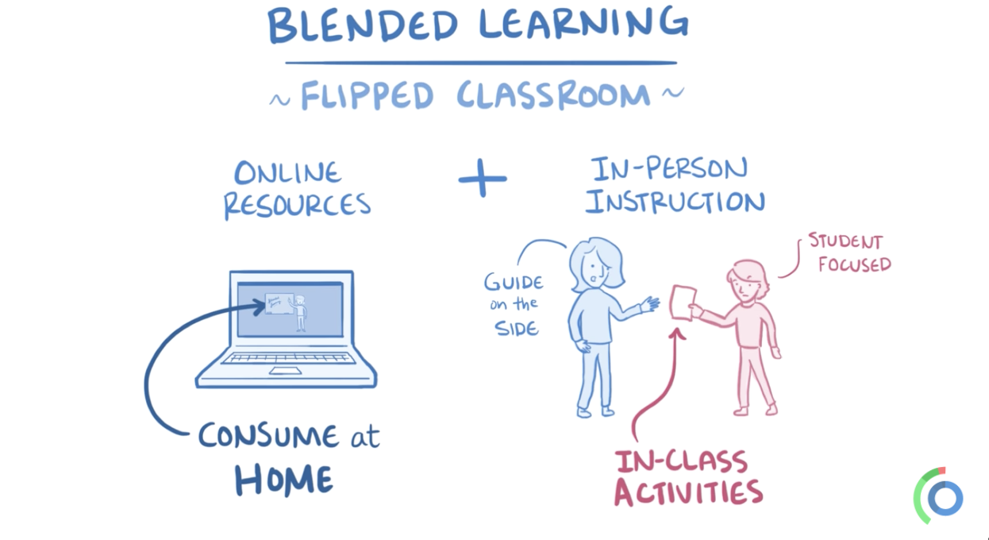
Source: openosmosis.org

Slide 18
Demo: run RStudio, install swirl, and start a swirl lesson

